Slide 1

Новая линейка силовых Si и SiC транзисторных модулей в корпусах LV100, HV100 для тяговых применений
13 мая 2021 г
Виктор Толстопятов
Инженер по применению силовых модулей

Slide 2


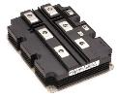



Outline of HV Development
series | package | Viso | picture
X series
(Si)
std
(standard)
6kVrms
10kVrms
Dual (RG)
（デュアル）
LV100
(6kVrms)
HV100
(10kVrms)
SiC
dual
dual
LV100
(6kVrms)

Slide 3
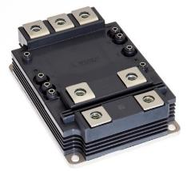
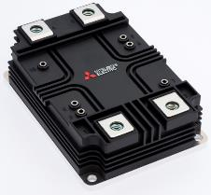
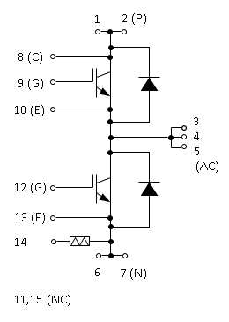
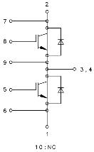
LV100/HV100 Type
Point
◆ 7th gen. IGBT chip and RFC diode chip reduce power loss
◆ Industry-leading power density* for increased inverter capacity
◆ The terminal layout is optimized for easy paralleling and flexible inverter configurations and capacities
Internal circuit
LV100 type
HV100 type
LV100 type
HV100 type
Notes:
40%改善

Slide 4
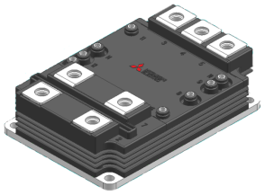
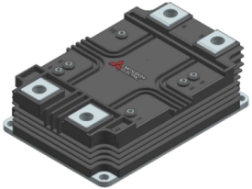
X-series Dual type : LV100 / HV100
Type | LV100 |  | HV100
Isolation | 6.0kV |  | 10.2kV
Rated voltage | 1.7 kV | 3.3 kV | 3.3 kV | 4.5kV | 6.5kV
Rated current | 1200A 900 A | 600A 450 A | 600A 450 A | 450A 350A | 300A 225A
Notes:
広報発表内容の事前通知と電源展とPCIM展示内容の紹介および推奨ドライバを準備中であることを伝える。

Slide 5
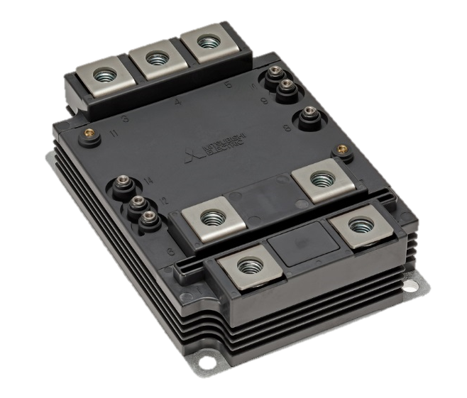
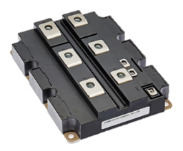
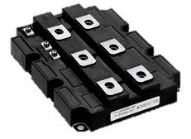
Power density comparison of 3.3kV/600A
3.3kV
CM600DC-66X
The highest current density in the industry is realized
CM1800HC-66X
CM1500HC-66R
CM1200HC-66H
8.57 A/cm²
6.77 A/cm²
5.64 A/cm²
4.51 A/cm²
Notes:
40%改善

Slide 6
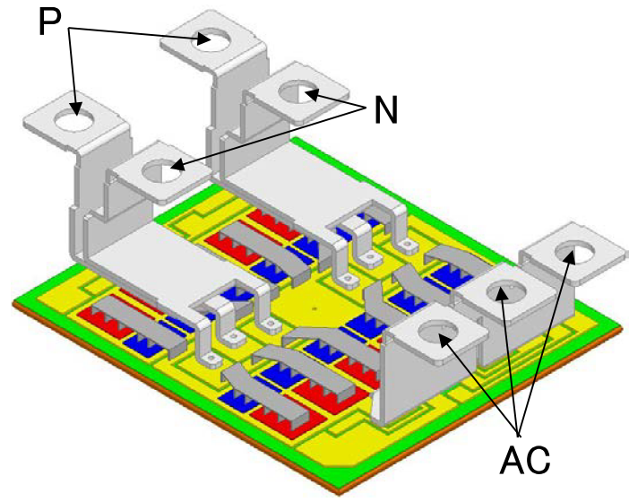
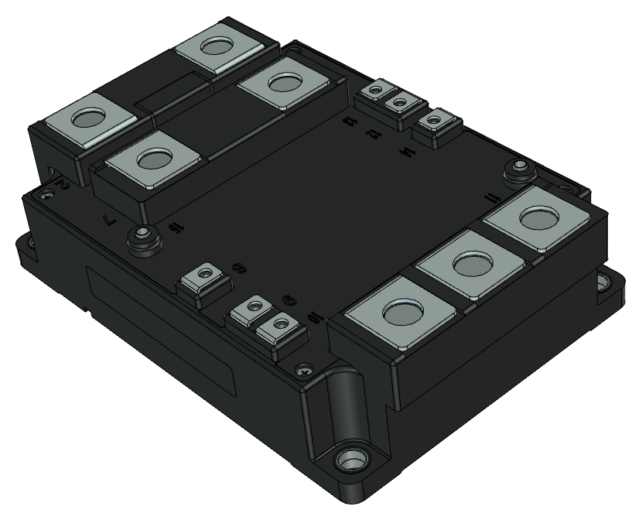
Low inductance package
Laminated terminal structure
➤Very low internal inductance by laminated/symmetrical structure

Slide 7
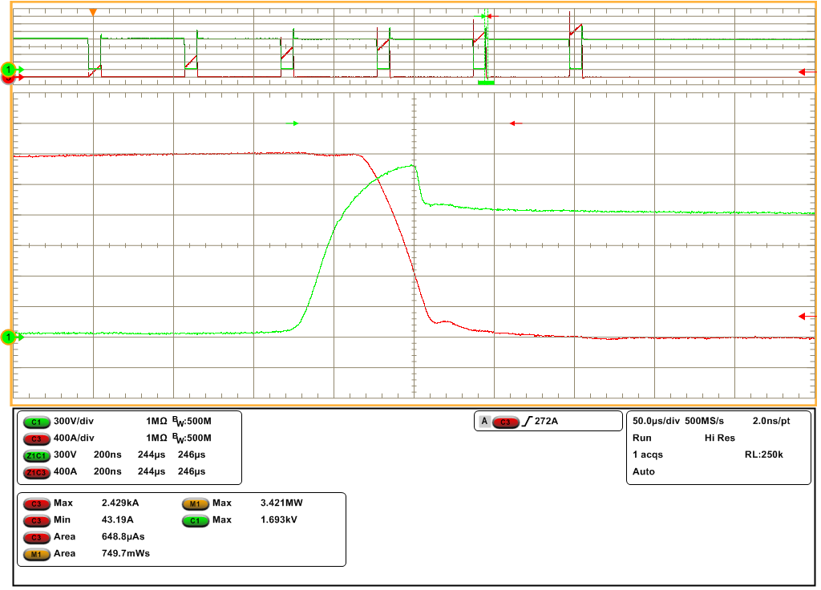
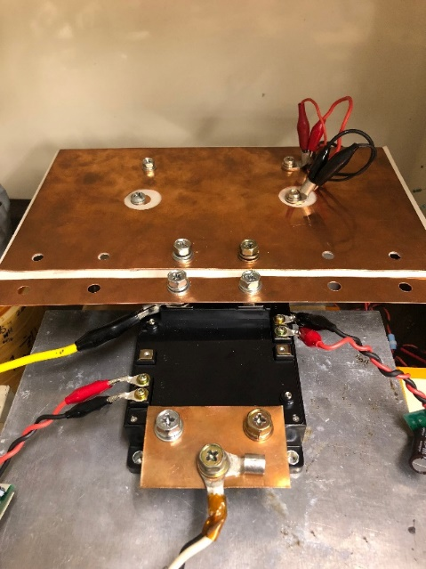
Low inductance package
No snubber capacitor
Turn-off Ic=2400A
V_{CEpeak}=1690V
V_{CC}=1200V
V_{CE}:300V/div
I_{C}:400A/div
time:200ns/div
1200A, 1700V module. Turn-off waveform
without snubber cap. @Tvj=25°C, R_{G}=0Ω
Inductive switching
test setup
➤Safe turn-off possible at large current without snubber capacitor
Notes:
・VCEモニタはセンス-センス
・N側波形。P側では1717Vをマーク。

Slide 8
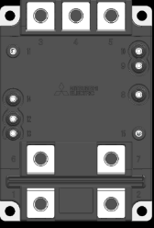
Easy parallel connection
3.3kV
CM450DC-66X
450A
900A
1350A
1800A
CM600DC-66X
600A
1200A
1800A
2400A
500A
1000A
1500A
2000A
2500A

Slide 9
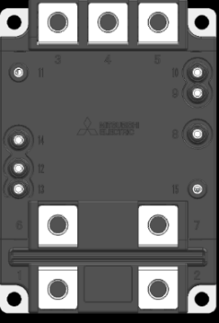
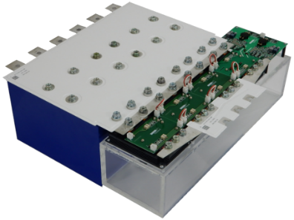
Example of bus bar Layout
DC side
Gate Driver
Laminated Busbar
DC side
Capacitor
AC side
HVIGBT LV100
Simple PCB layout and simple output line layout
AC side

Slide 10
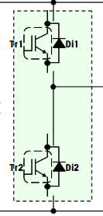
Optimized Layout
ideal module
(terminal and chip arrangement is perpendicular to current flow)
LV100
(based on ideal module concept)
Conventional Module
(chips arrangement is parallel to current flow)
P-side
chips
AC
AC
AC
AC
Current
direction
(only Y)
N
P
AC
N-side
chips
N
N
N
P
P
Current direction is mainly X
Y
P
All chips have same impedance
All chips have almost same impedance
All chips have different impedance
X

Slide 11
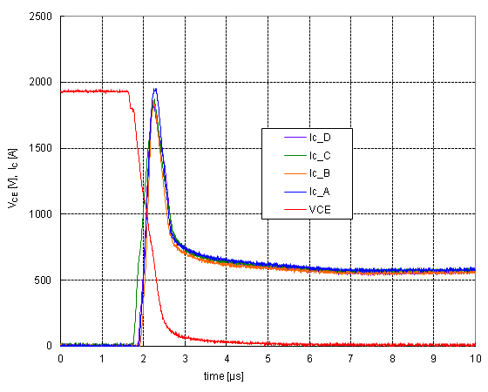
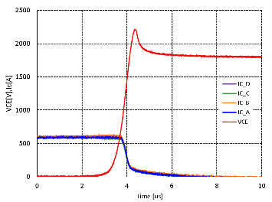
Switching behavior in 4 parallel
3.3kV/600A
Condition: V_{CC} = 1800V, I_{C} = 600A/module, T_{j} = 150℃
Turn-on
Turn-off
V_{CE}
V_{CE}
I_{C_A}
I_{C_B}
I_{C_B}
I_{C_A}
I_{C_C}
I_{C_D}
I_{C_D}
I_{C_C}
 | di/dt [A/μs] | I_{CP} [A] | E_{on} [J] | I_{C} [A]
#A | 5133 | 1955 | 0.558 | 607
#B | 5163 | 1864 | 0.482 | 581
#C | 5709 | 1872 | 0.749 | 598
#D | 4271 | 1833 | 0.571 | 589
Δ/ave | 28.4 % | 6.5 % | 45.2 % | 4.4 %
 | di/dt [A/μs] | E_{off} [J] | I_{C} [A]
#A | 1672 | 1.12 | 592
#B | 1682 | 1.09 | 604
#C | 1622 | 1.00 | 588
#D | 1704 | 1.04 | 604
Δ/ave | 5.0% | 9.0% | 2.7%
Notes:
40%改善

Slide 12
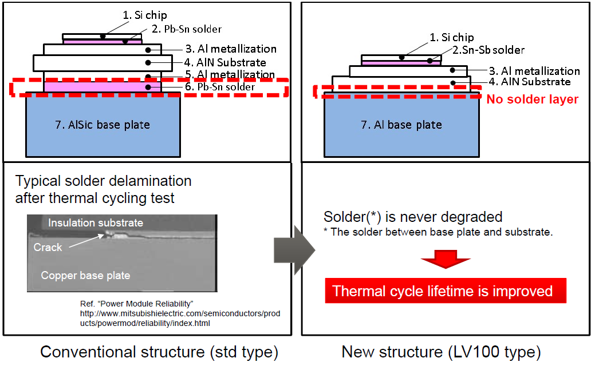
Technical advantages
Notes:
40%改善

Slide 13
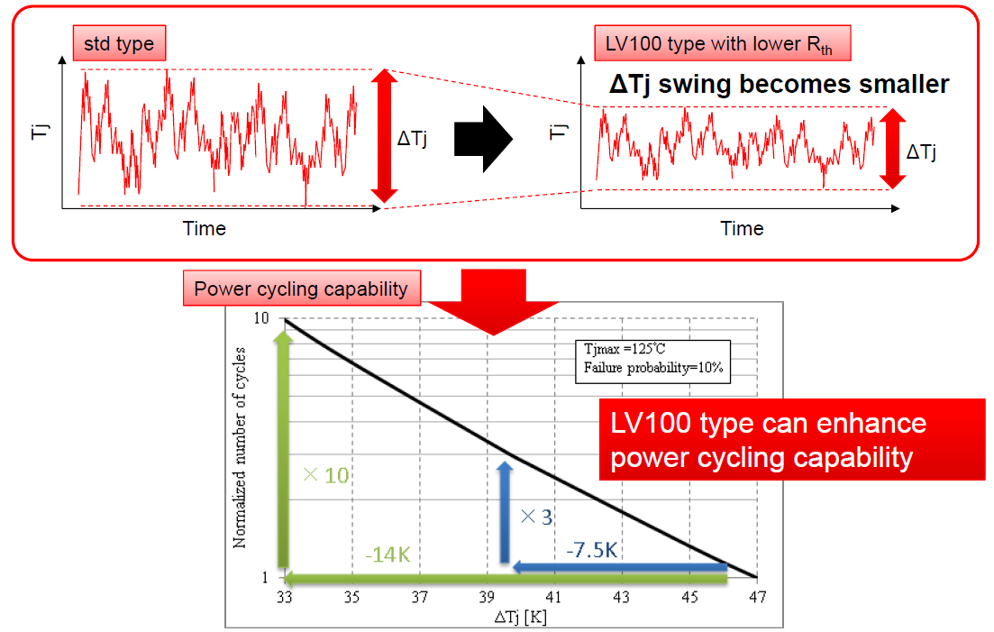
The new package structure for high reliability Tj
Notes:
40%改善

Slide 14
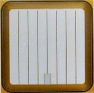
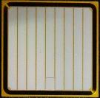
Chip technologies
Inverter losses reduction
New trench gate structure
→ CSTBTTM (III)
Higher carrier concentration at emitter side under on-state
Lower V_{CEsat}
①CSTBTTM(Ⅲ)
②LNFLR + SCC
Improvement output current & Rth
New edge termination structure
→ LNFLR(Linearly-Narrowed Field Limiting Ring)
+SCC (Surface Charge Control)
Active area is increased by shrinking edge termination area
Robustness against humidity
③Partial P-Collector
Partial P collector
Wide SOA margin
→ Partial P collector
Minimize hole injection efficiency in edge termination
R-Series
X-Series
3.3kV IGBT
CSTBTTM (III) (CSTBT: Carrier Stored Trench Gate Bipolar Transistor)
Notes:
40%改善

Slide 15
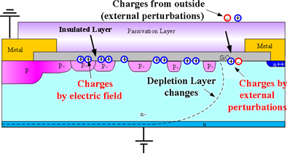
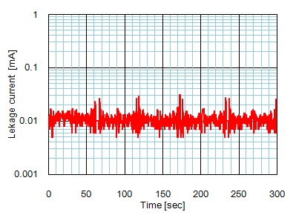

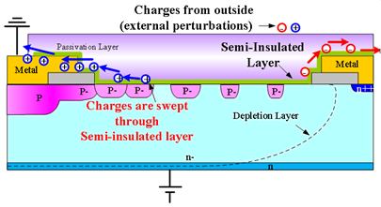
Robustness against humidity
(Surface Charge Control technology)
Conventional structure
SCC (Surface Charge Control)
Surface charge due to humidity is discharged and therefore robustness against humidity is achieved.
Condensation test result
(CM1000HG-130XA)
X-series structure (SCC technology)
Gel appearance
(foggy)
No I_{CES} increase!

Slide 16
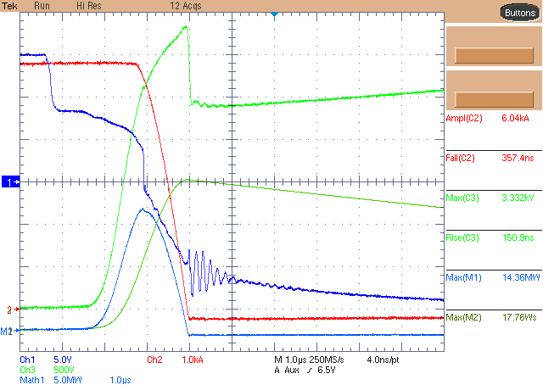
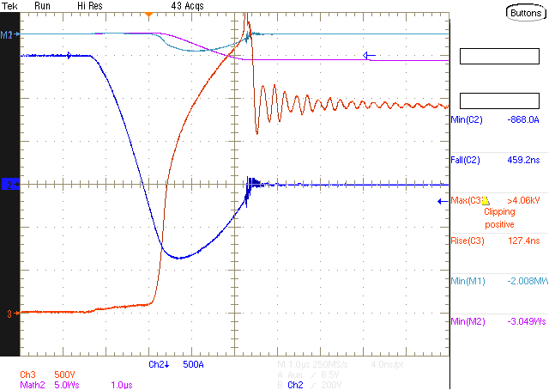
Wide SOA margin
Design target: 2 times higher than SOA
RBSOA & RRSOA Type test (CM1500HC-66R)
RBSOA Type test
RRSOA Type test
2 times
2 times
Conditions :
T_{j} = 150 °C, V_{CC} = 2500 V, I_{C} = 6000 A, L_{S} = 140 nH
Conditions :
Tj=150°C, Vcc=2500V, di/dt & Ls= adjustable

Slide 17
Improved Power cycling lifetime:
More than 2 times improved new X-Series design

Slide 18
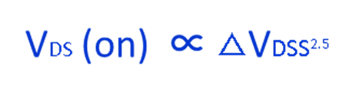
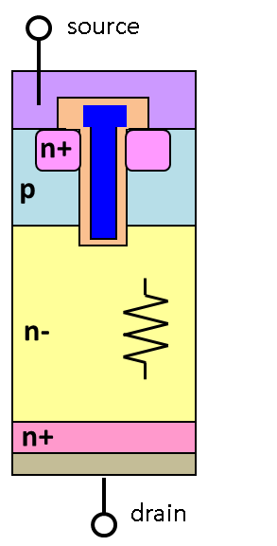

Benefit of SiC power device
ON state voltage comparison MOSFET vs IGBT on Si base
 |  | MOSFET | IGBT
Blocking voltage (V) | Thickness of n- layer (um) | V_{DS}(on) (V) | V_{CEsat} (V)
600 | 50 | 1.6 | 1.6
1200 | 100 | 9.0 | 1.8
1700 | 140 | 21.5 | 2.0
ON state voltage of IGBT is reduced
by conductivity modulation
 | carrier | Blocking voltage | SW loss | territory
MOSFET | Electron (unipolar) |  |  | < 600V
IGBT | Electron + Hole (bipolar) |  |  | > 600V

Slide 19
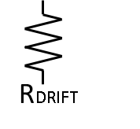
10 times higher
breakdown strength than Si
material | Breakdown strength (V / um )
4H-SiC | 300
Si | 30
1200V Si-MOSFET
1200V SiC-MOSFET
source
source
n+
n+
p
p
n-
≒10µm
n+
n-
≒100µm
drain
RDRIFT
n+
ON state voltage
Si >> SiC
drain

Slide 20
LV100 Hybrid SiC modules
SiC-SBD
Type | Product | Model | Specification | Dimensions
LV100 (6kViso) | SiC hybrid module | CMH1200DA-34X | 1.7kV/1200A/2in1 | 100×140×40mm³
 |  | CMH600DA-66X | 3.3kV/600A/2in1

Slide 21
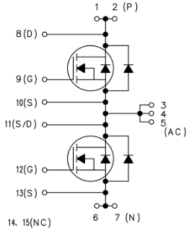
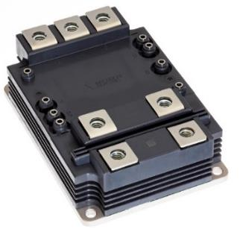
LV100 3.3kV Full SiC module
Type | Product | Model | Specification | Dimensions
LV100 (6kViso) | Full-SiC module | FMF750DC-66A | 3.3kV/750A/2in1 | 100×140×40mm³

Slide 22
Inverter loss Comparison
condition:
V_{CC} = 1800V, I_{O} = 450Apeak, fc = 5kHz, P.F.=0.85, M=1
-45%
-76%
Si IGBT
Hybrid SiC
Full SiC

Slide 23
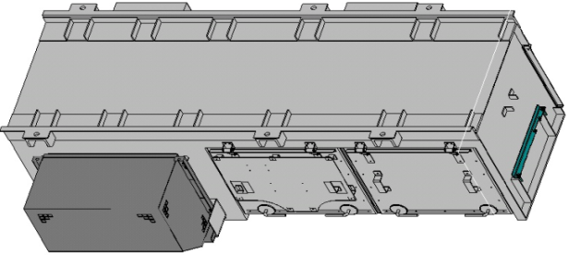
SiC Merits in railway application
Requirement from Rail Car market
to save energy
to fully utilize limited underfloor space, smaller inverter is desirable
Limited space
SiC
MOS
SiC-SBD
Full-SiC power module
Propulsion Inverter

Slide 24
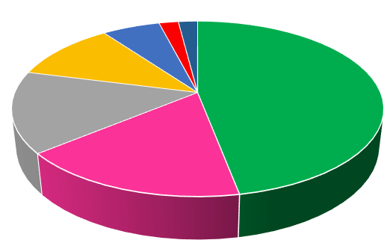
SiC Merits in railway application
Save energy in smaller space
Energy loss share of Propulsion Inverter
Invertor loss is not majority
Invertor 2%
Others 2%
Gear 6%
Filter loss 11%
Mechanical brake 15%
Running Resistance 47%
Motor loss 17%
focus on these two points

Slide 25


SiC Merits in railway application
Motor loss improvement
wave form with conventional invertor
Current distortion
Current
voltage
Ideal sine wave
harmonic loss reduction
wave form with high switching SiC invertor
Current
voltage
Ideal sine wave
Motor harmonic loss can be reduced on smaller cooling fin
by SiC power module

Slide 26


SiC Merits in railway application
Mechanical loss improvement → Regenerative brake area expansion
Conventional brake system
Regenerative brake can return kinetic energy to catenary
Mechanical brake
Brake power
Regenerative brake
speed
0
high
Regeneration brake power is expanded
Developed brake system
Mechanical brake
Brake power
Regenerative brake
speed
Synchronous
rectification
0
high
SW
device
diode
Regenerative brake power can be expanded on smaller
cooling fin by SiC power module

Slide 27

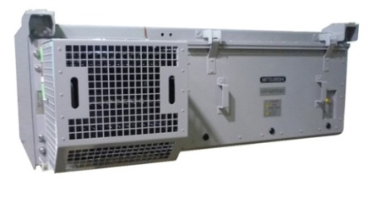
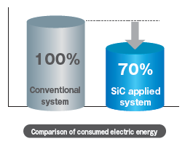
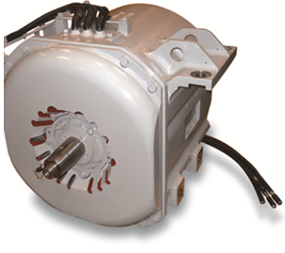

SiC Merits in railway application
Results on SiC power module
Regenerative power expansion
motor harmonic loss
reduction
Energy consumption
comparison
Conventional
inverter
Full-SiC
inverter
Save energy on smaller size was realized

Slide 28

Save energy in smaller space
Auxiliary power supply
Auxiliary power supply circuit example
others
Filter
reactor
invertor
AC filter
breaker
AC filter
breaker
AC out
capacitor
Filter
reactor
invertor
capacitor
Trans former
リーケージトランス又はリアクトル
volume share of Auxiliary power supply
Volume share of AC filter and invertor are more than 50%
cooling fin kept smaller due to power loss reduction by SiC power module.
AC filter size kept smaller due to higher fc by SiC power modules.
Notes:
箱内に収める部品が、走行用インバータ装置と異なる。巻物を箱内に抱いている。
＜語順注意＞
スイッチングリプルを負荷側に漏えいさせないためのフィルタ用のＡＣリアクトルがポイント。
変圧（絶縁）機能のためのトランスの、漏れインダクタンスで代用できるくらいに高周波化するとインパクト。 「又は」⇒「および」

Slide 29
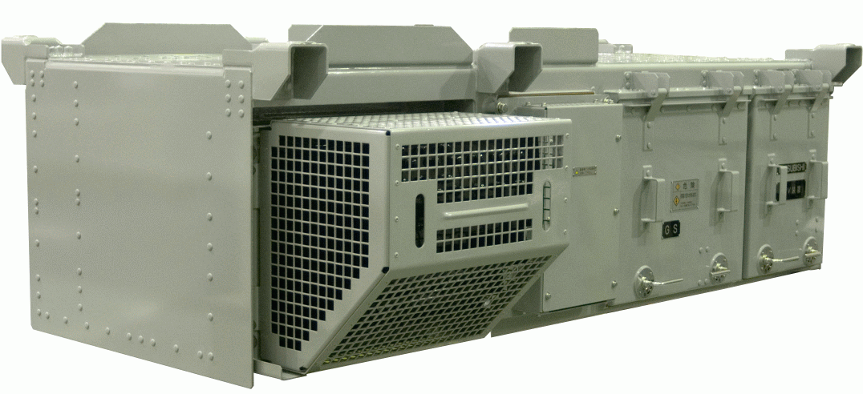
Save energy in smaller space
Results of Auxiliary power supply
Out put : AC 200V 60Hz
Output power：140kVA
Cooling：air cooling
Power supply
Cooling fin of inverter was kept smaller due to power loss reduction
by SiC power module.
AC filter size kept smaller due to higher fc by SiC power modules.
●size : 20% down & weight : 15% down
●energy saving : total loss reduce 30%
●noise reduction -4dB
To Save energy in smaller space is realized by SiC module
Notes:
EMCも改善可能か
●TMK1000に納入した添付のSiC補助電源:2280Hz(同案件Si装置:1620Hz)
·その他SiC補助電源:2340Hz、3060Hz、4500Hz、5.5kHzなど
·一般的なこれまでのSiの補助電源装置:1950Hz、2340Hz
●他社さんから、full-SiCで、高周波リンクタイプのご提案あり。
今後、高周波タイプへの対応も広がる。リアクトル等の選定、最適化が課題

Slide 30
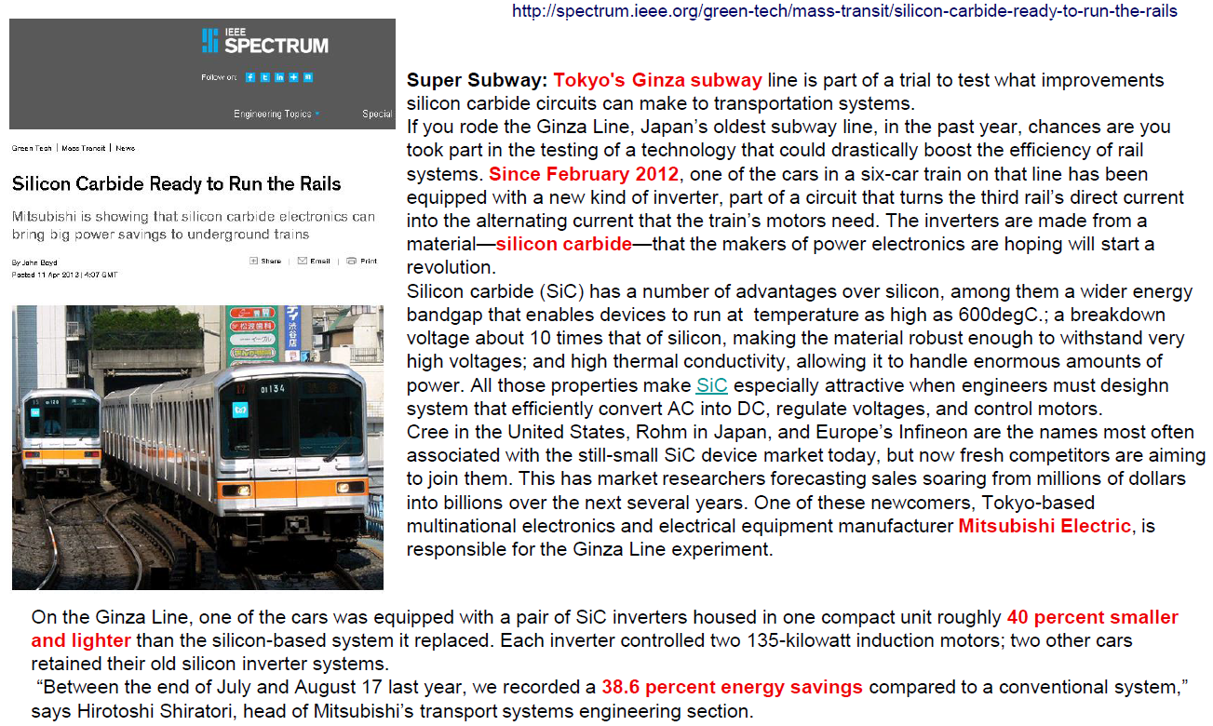
1.7kV SiC Hybrid Module for Traction Application

Slide 31

END
Виктор Толстопятов
victor.tolstopyatov@mer.mee.com
Phone/WhatsApp: +7-985-490-26-03

